Slide 1
bb
Sequence 5_ Life Cycle Costing_ Engineering Economics
Dr. Hassan Ashraf
Engineering Economics _ CU Islamabad _ Wah Campus _ Civil Engineering Department _ FALL 2020 Semester

Slide 2
Life-Cycle Costing
The key tools used in this process is economic decision analysis, which, in the construction industry, is referred to as the “life-cycle costing technique.”
The designer of a construction project is constantly faced with alternatives as they progress through the design process; life-cycle costing ensures that the best alternatives are chosen.
Rather than making a choice simply on the basis of least cost, life cycle costing provides a mechanism to determine which alternative offers the largest economic advantage by considering costs and benefits that occur throughout the life of the development – from its initial conception through its construction and its useful life to the time it is ready for replacement.

Slide 3
What is Life-Cycle Costing
The process of life-cycle-costing (LCC) treats design decisions as investments, taking into account outlays and payback over the life of these investments. LCC seeks to reduce the overall cost of a project by selecting designs and components, which minimize the owner’s expenses not just at the time of construction but also over the full life of that project.
In this process the cash flows of alternative designs and components are analyzed to determine which of the options provides the higher net benefit to the owner when all costs are accounted for, not just the initial capital costs of construction. Often the prime question is: Should we spend extra now on a component in exchange of the promise of added benefits in the future? Calculations can show that the additional investment in the component is justified by the greater benefits obtained over the term of investment.

Slide 4
What is Life-Cycle Costing
Life cycle costing provides a framework for making assessments of costs and benefits based on the “ time value” of money. This allows the analyst to compare and select from alternatives that have different life spans and diverse cost and benefit profiles.

Slide 5
The notion of Equivalence
Given a chance of receiving $100 now or receiving $100 three years from now, just about everyone will opt to receive it now. There are several good reasons for this. First, most people have a current need for cash. They have bills to pay today, so cash now is obviously preferred to a promise of some amount in the future. Second, there is always some risk attached to the future. How sure are you of getting the promised future sum? Will $100 buy the same amount in three years as it can now? There is far more certainty when the sum is in your hand right now. But even if you do not have a great need for cash currently and the promise of the future payment is from a very reliable source, there is still a third, very persuasive reason for taking the cash now. You could invest the sum and, with interest, have a larger amount in three years. It is for these reasons, and especially because interest is paid on loans, that the value of money declines with time.

Slide 6
The notion of Equivalence
However, if the amount offered three years from now is greater than that offered now, say $150 in three years or $100 now, some people may be willing to wait for the larger sum. The need for immediate cash and the amount of risk involved will be different for each individual; certain people will still prefer the cash now. Other people may find it very difficult to decide; for them the future $150 is worth exactly $100 now. For these individuals, the two amounts are equivalent. The analysis that follows is based on this concept: Different sums of money that are time separated can be equivalent to each other.

Slide 7
Compound Interest Calculations
If you are going to need $9,000 in 6 years to pay for the replacement of a building component, would you have sufficient funds at that time if you deposited $5,000 in a bank account yielding 10% interest compounded annually?
Answer: F = P (1+i)N
F= $5,000 (1.10)6
F= $ 8,857.80
Therefore, this investment would not generate sufficient funds to pay for the replacement.

Slide 8
Compound Interest Calculations
Example 2
If a $10,000 sum were required 12 years from now, how much would you need to invest now when the interest paid on the investment is 6% compounded annually?
Answer: P= F/ (1+i)N
P= 10,000/(1.06)12
P= $4,969.69
Therefore, $4,969.69 invested now will generate the required funds.

Slide 9
Nominal and effective interest rates
Interest rates are usually stated as an amount per year disregarding any compounding that occurs during the year. This rate is referred to as the “nominal interest rate”; for example, a bank may state its interest rate on loans is 12%, which is the nominal annual rate. If compounding occurs monthly, the interest rate per period will be 12% divided by 12 months, or 1% per month. The effective rate per year can be calculated using the formula:
i= (1+r/t)t – 1
Where: i is the effective interest rate
r is the nominal interest rate
t is number of compounding periods per year
So, in the case of the bank loan, the effective interest rate is calculated thus:

Slide 10
Nominal and effective interest rates
I = ( 1 + r/t )t – 1
I = ( 1+ 0.12/12)12-1
I = ( 1.01)12 – 1
I = 0.1268 ( 12.68% per year)
So, a normal interest rate of 12% compounded monthly is an effective rate of 12.68%.

Slide 11
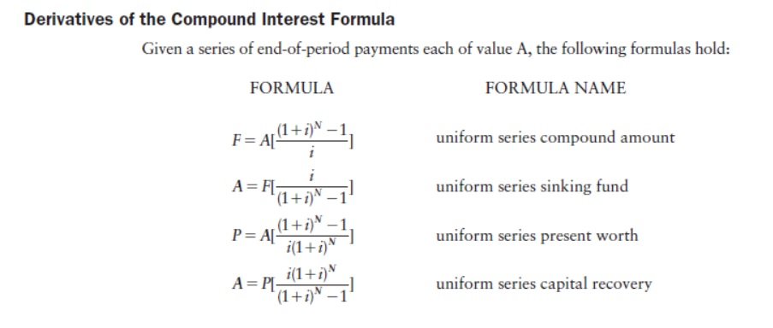
Derivatives of the Compound Interest Formula

Slide 12
Using Tables
The expression (1+i)N in the compound interest formula is known as the “ compound amount factor” and is denoted by (F/P, i%, N). This factor is applied to determine a future amount F given a present amount P compounded at an interest rate of i% over N periods. The value of compound amount factors can be obtained from compound interest tables that list values of various interest rates over various periods.
F = P ( F/P, i%, N)
To solve this equation, the present value P is multiplied by the appropriate F/P factor obtained from the tables.

Slide 13
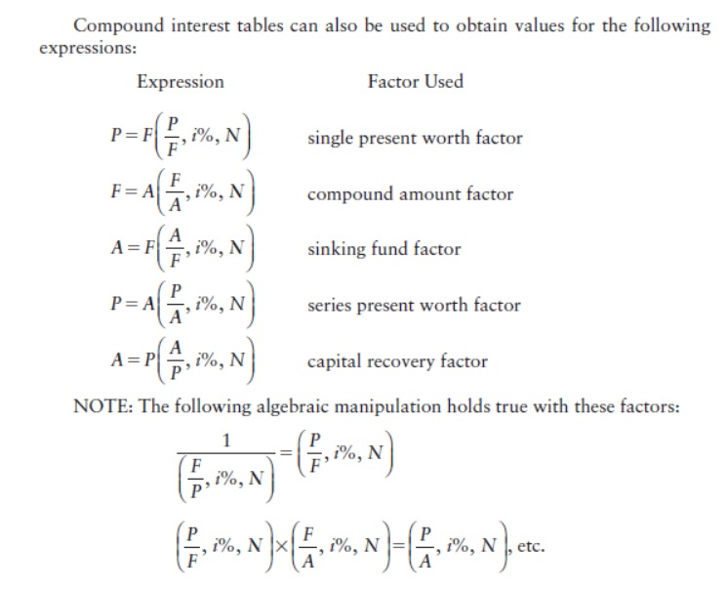
Using Tables

Slide 14
Example
How much would you have at the end of 10 years if you invested $150,000 at 8% interest compounded annually?
Answer: F= P ( F/P, 8%, 10)
F= $ 150,000 (2.1589)
F= $ 323,835.00
Therefore, you would have $323,835.00 in this account after 10 years.

Slide 15
Example
Adding insulation to a ceiling will save $ 3,250 annually over a 15-year period. If the interest rate is 10%, what is the present worth of these savings?
Answer: P= A ( P/A, 10%, 15)
P = $ 3250 (7.6061)
P = $ 22,948.25
Therefore, the present worth of the savings is $22,948.25

Slide 16
Compounding Periods
As stated above, compounding can occur more frequently than annually. There could be semi-annual compounding (every 6 months), quarterly compounding ( every 3 months), monthly compounding, and even daily compounding. In life-cycle costing analysis, the most common compounding period is monthly because payments are usually made monthly.
In order for the time value of money formulas to function, the interest rate must always correspond to the period. In other words, if the period is monthly, the interest rate must be per month.
If the annual interest rate is 18% ( the nominal rate) and compounding is monthly, then the monthly interest rate is 1.5% ( 18%/12)

Slide 17
Compounding Periods
Conversely, if the monthly rate is 1%, then the nominal annual rate is 12% ( 12 x 1%). So, in general terms, the nominal interest rate = the interest rate per period multiplied by the number of compounding periods per year.

Slide 18
Problem # 01
Floor Finish A costs $100,000 to install and will cost $20,000 to remove 10 years from now. Floor finish B costs $105,000 and there is no removal cost. Which floor finish should be adopted if the discount rate is 8% compounded annually?
Present worth of Floor Finish type A = 100,000 + 20,000 ( P/F, 8%,10)
= $100,000 + $20,000 (0.46319)
= $ 109,264
Floor Finish B’s Present Cost < Floor Finish A’s Present Cost
Therefore, Select Floor Finish B.

Slide 19
Problem # 01
0
10
Floor Finish A
20,000
100,000
0
10
Floor Finish B
105,000

Slide 20
Problem # 01
The first method we used to compare the alternatives employed the concept of comparison of costs of both alternatives.
However;
We can solve problems by comparing the net benefits as well. Net Benefit represent the amount when the present worth of costs is deducted from the present worth of benefits.
In Problem # 01, there are no inflows and therefore we cannot apply the concept of comparing net benefits. In this example, the best way to deal with the problem is to compare the Present worth of Costs. The Alternative with the lowest costs will be selected.

Slide 21
Problem # 02
Below are the costs and savings over a 20-year period associated with three ways to upgrade windows. If the discount rate is 6%, which alternative is best?
 | ALT 1 | ALT 2 | ALT 3
Initial Cost | $23,000 | $31,000 | $35,000
Annual Savings | $2,900 | 3,700 | 4,000
Here in this problem we can see that both costs and savings are given, therefore, we can employ the concept of NPV or PW of Net benefits to compare the alternatives.

Slide 22
Problem # 02
ALT 1 : Net Present Worth = -23,000 + $2,900 ( p/A, 6%,20)
= -23,000 + 2,900 (11.4699)
= +10,263
ALT 2 : Net Present Worth = -31,000 + 3700 (P/A, 6%,20)
= -31,000 + 3,700 (11.4699)
= 11,439
ALT 3 : Net Present Worth = -35,000 + 45000 (P/A,6%,20)
= -35,000 + 4,500 (11.4699) = 10,880
Therefore, Select Alternative 2 as it has the highest net benefit.

Slide 23
Problem # 03
Light Fixture type X costs $10,000 and lasts for 4 years, while fixture type Y costs $14,000 and lasts for 6 years. Which should be selected if the discount rate is 5%?
What is different in this problem?
Deliberate and tell how this problem is different from the previous problem.

Slide 24
Problem # 03
This problem is different from the perspective that both alternatives have unequal life spans. When life spans are unequal, we cannot simply compare them unless the lives have been made equal.
What we can do is, we can find out the time horizon at which the life spans of both alternatives will become equal.
In, the said problem, one alternative has a life span of 4 years while the other has a life span of 6 years. The lowest common multiple will tell you about the time horizon at which the life spans of both alternatives will become equal. For 6 and 4, the lowest common multiple is 12. It means, if we have to compare these alternatives, we will be using the life span for both alternatives as 12.

Slide 25
Problem # 03
To finance type Y fixtures over 12 years, 14,000 will be spent now and 14,000 after 6 years.
PW of cash flows = 10,000 + 10,000 (( P/F,5%,4) + ( P/F, 5%,8))
= 10,000 + 10,000 ((0.82270) + ( 0.67684))
= 24,995
PW of cash flow Y = 14,000 + 14,000 ( P/F,5%,6)
= 14,000 + 14,000 (0.74622)
= 24,447
Therefore, select Fixture Y since it has the lower present worth of costs.

Slide 26
Problem # 03
0
4
8
12
Fixture Type X
10,000
10,000
10,000
0
12
Fixture Type Y
14,000
14,000

Slide 27
Problem # 04
Wall finish A costs $12,000 to install and has an annual maintenance of $2,000. Wall finish B costs $9,500 to install with an annual maintenance of $3,200. If the finishes are expected to last for 6 years, what is the better alternative when the interest rate is 12%?
EUAC of A = $12,000 ( A/P , 12%,6) +$2,000
= $12,000 (0.2432) + $2,000
= $4918 per year
EUAC of B = $9,500 (A/P, 12%,6) +$,3200
= $9,500 (0.2432) + $3,200
= $ 5510 per year
Therefore, select Alternative A since it has the lower equivalent uniform annual cost.

Slide 28
Problem # 04
0
1
2
3
4
5
6
Wall Finish A
2,000
2,000
2,000
2,000
2,000
2,000
12,000
0
1
2
3
4
5
6
Wall Finish B
3,200
3,200
3,200
3,200
3,200
3,200
9,500

Slide 29
Problem # 05
The cost of conventional control system for a development is $4,000,000 with annual maintenance costs of $22,000. The cost of an electronic control system is $5,500,000 with annual maintenance of $25,000.

Slide 30
bb
Thank You

